Slide 1
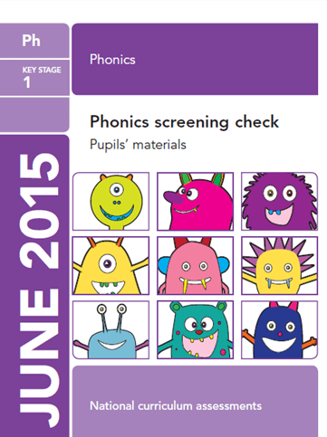

Year 1
Phonics Screening Check

Slide 2
What is phonics?
The children have been learning phonics since they started in Reception.
Throughout this time they have learnt sounds in a set order.
They have also learnt the skills of blending.

Slide 3
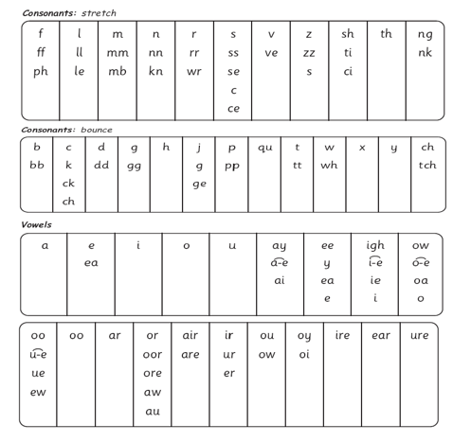
Sounds
There are 44 sounds (phonemes) to learn but
there are over 150 graphemes (ways in
which to write each sound). This makes
it a very complex code.
2 or 3 letters that make a sound are
known as special friends.

Slide 4
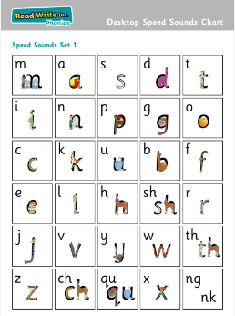
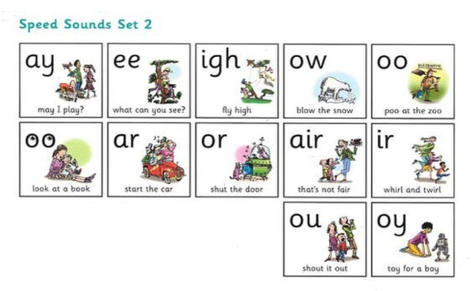
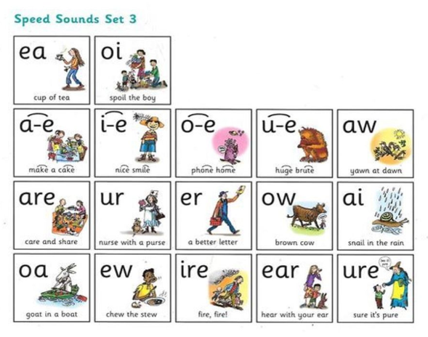
Read Write Inc.
There are 3 sets of sounds.

Slide 5
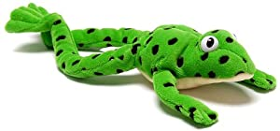
Blending
Children are taught the sounds as pure sounds so that they are able to blend accurately. When children say the sounds out loud we call this Fredding. This is because Fred the frog can only talk in sounds so the children have to help him blend.

Slide 6
Blending
m – a – t (3 sounds)
ch – o – p (3 sounds)
l – igh – t (3 sounds)
c – r – ea - m (4 sounds)
s – t – a – m – p (5 sounds)

Slide 7
Red Words
These words are the words that are not decodable using phonics,
e.g. the
you
was
come
These will not be tested in the screening check

Slide 8
What is the Screening Check?
The Phonics Screening Check is a national test that is administered to children in Year 1. The test has been designed to confirm whether individual children have learnt sufficient skills in phonic decoding and blending for their age.
The test is administered on a one-to-one basis and will be administered by Mrs Waters. The children will have 40 words to read. Half of these will be real words and half will be nonsense words. The children read one word at a time and can work through at their own pace. At the end of the text there are some multi-syllabic words. It usually takes approx. 10 - 15 minutes per child.

Slide 9
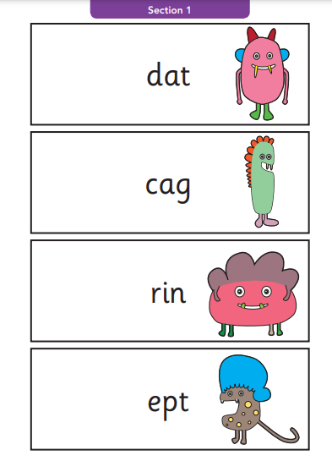
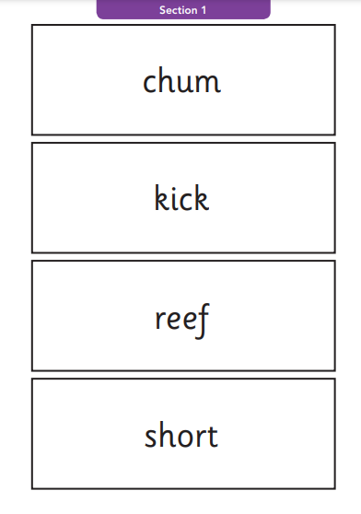

Slide 10
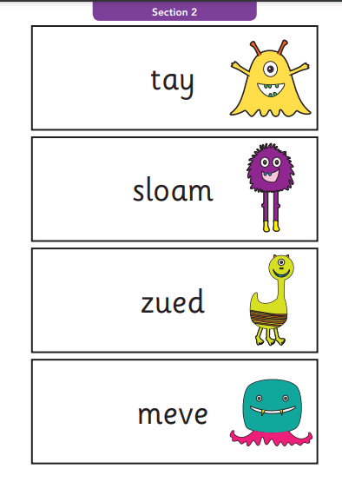
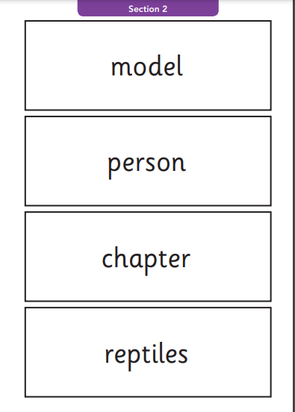

Slide 11
When will the screening take place?
The tests will be administered throughout the week of 8th June 2026. It may be on any day during that week so please ensure your child has good attendance at this time.

Slide 12
Reporting to Parents
In the end of year report you will be given your child’s score out of 40. In previous years the pass mark has been 32 out of 40.
If your child does not reach the expected standard they will continue to work on phonics in Year 2 and re-take the screening check in Year 2.

Slide 13
How can you support your child?
Continue to read daily with your child.
Help your child with sounds that they are unsure of.
Help them to spot special friends. Take extra care with split sounds.
Play games with phonics.
Watch the portal videos.

Slide 14
Activities to try today
iPads – phonics play
Trash and treasure
Practise reading green words
Practise reading nonsense words
Mosaic colouring
Read and roll

Slide 15
Thank you!

